Slide 1
Efficient Estimation of Word Representations in Vector Space
2017/11/6
宋治勋

Slide 2
Introduction
It was found that similarity of word representations goes beyond simple syntactic regularities.
eg. vector(king) - vector(man)+vector(woman)
Results in a vector that is closest to the vector representation of the word Queen
We design a new comprehensive test set for measuring both syntactic and semantic regularities
And show that many such regularities.can be learned with high accuracy. Moreover, we discuss how training time and accuracy depends on the dimensionality of the word vectors and on the amount of the training data.

Slide 3
Model Architectures
focus on distributed representations of words learned by neural networks.(not LSA, LDA)
goal: maximize the accuracy, while minimizing the computational complexity

Slide 4
Feedforward Neural Net Language Model (NNLM)
Input: N previous words are encoded using 1-of-V coding
Projection: N x D
Hidden: H
Output: V
Input -> Projection (cheap operation)
Projection -> Hidden (complex *, dense vector)
Hidden -> Output (probability distribution)
For a common choice of N = 10, the size of the projection layer (P ) might be 500 to 2000, while the hidden layer size H is typically 500 to 1000 units.
Q = N × D + N × D × H + H × V

Slide 5
Feedforward Neural Net Language Model (NNLM)
Avoiding H x V: using hierarchical versions of the softmax.
Huffman trees assign short binary codes to frequent words, and this further reduces the number of output units that need to be evaluated.
Go down : log 2 (V )
Most of the complexity is caused by the term N × D × H.

Slide 6
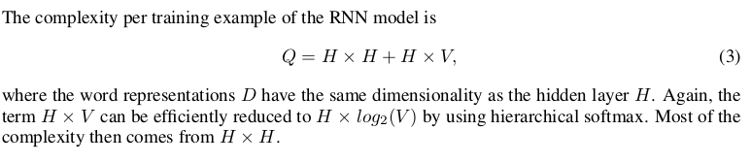
Recurrent Neural Net Language Model (RNNLM)
Overcome certain limitations of the feedforward NNLM.
No need for N
Input, Hidden, Output

Slide 7
New Log-linear Models
two new model architectures for learning distributed representations of words that try to minimize computational complexity.
(no hidden)
The main observation from the previous section was that most of the complexity is caused by the non-linear hidden layer in the model

Slide 8
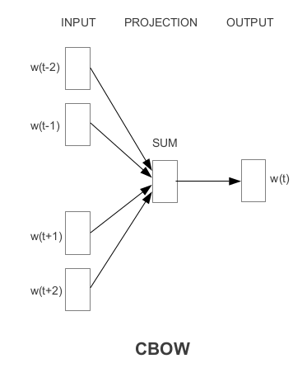

CBOW
The first proposed architecture is similar to the feedforward NNLM, where the non-linear hidden layer is removed and the projection layer is shared for all words;
All words get projected into the same position (their vectors are averaged).
the order of words in the history does not influence the projection.

Slide 9
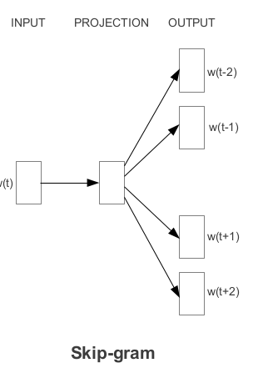

Skip-gram
The second architecture is similar to CBOW, but instead of predicting the current word based on the context, it tries to maximize classification of a word based on another word in the same sentence.
We found that increasing the range improves quality of the resulting word vectors, but it also increases the computational complexity.
we give less weight to the distant words by sampling less from those words in our training examples.
Notes:
where C is the maximum distance of the words. Thus, if we choose C = 5, for each training word
we will select randomly a number R in range < 1; C >

Slide 10
Results: Eval method
previous papers typically use a table showing example words and their most similar words, and understand them intuitively.
there can be many different types of similarities between words.
big -> bigger , while small -> smaller
big -> biggest, while small -> smallest
using algebra operation.

Slide 11
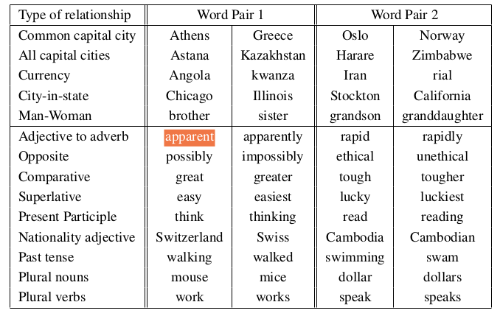
1. There are 8869 semantic and 10675 syntactic questions.
2. For example, we made a list of 68 large American cities and the states they belong to, and formed about 2.5K questions by picking two word pairs at random.
3. correct: only same. synonyms are counted as mistakes.

Slide 12
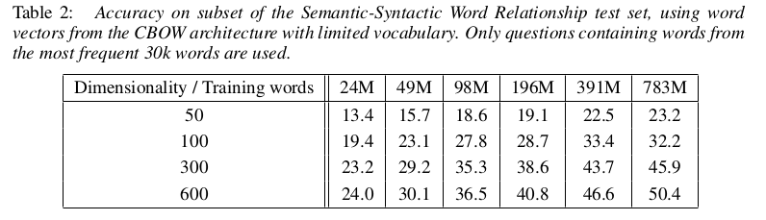
Result: Maximization of Accuracy
time constrained optimization problem (huge train data)

Slide 13
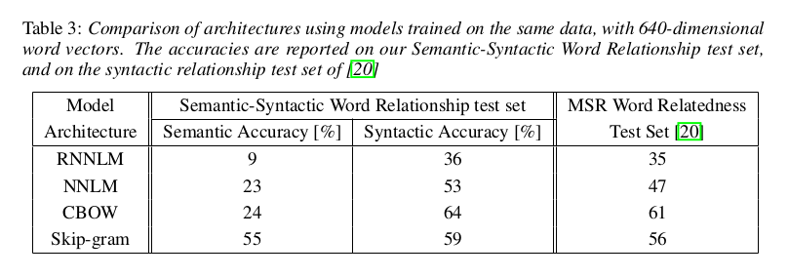
This is not surprising, as the word vectors in the RNNLM are directly connected to a non-linear hidden layer.

Slide 14
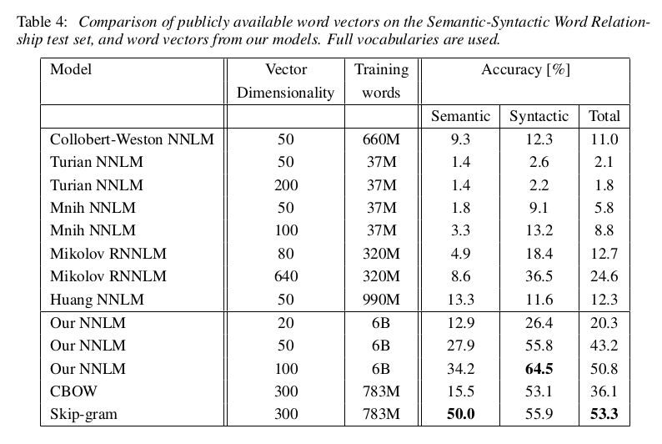
Comparison of Model Architectures

Slide 15
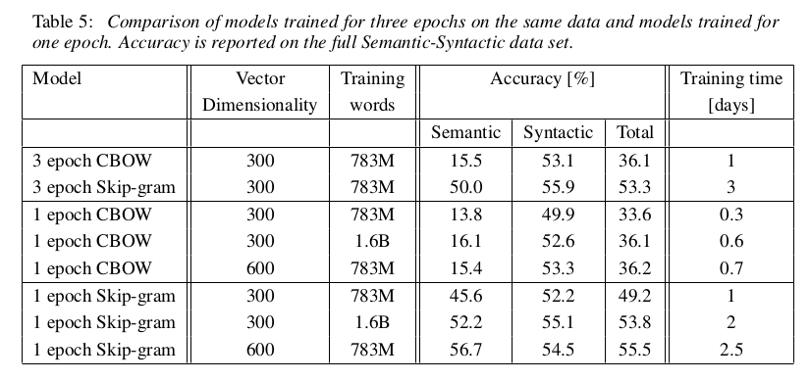

Slide 16
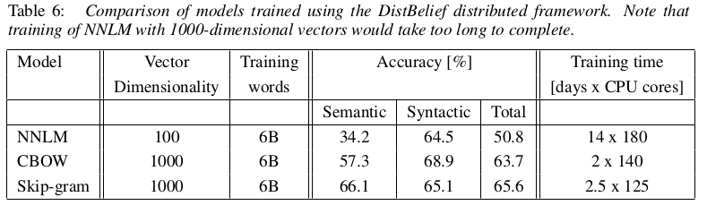

Slide 17
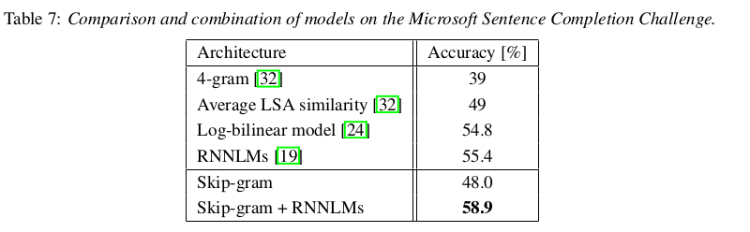

Slide 18
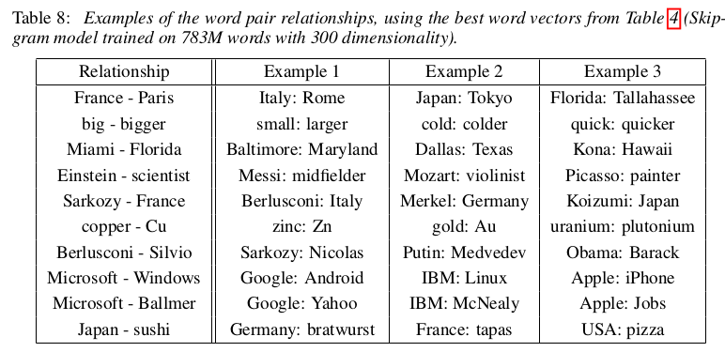
By using ten examples instead of one to form the relationship vector (we average the individual vectors together)

